Slide 1
MIMO Based Radio-over-Fiber link for Millimeter Wave Generation Using an External Optical Modulator

Slide 2
Our Team
Taohid Khan
Reg:22101070
Tanvir Rahan Rifat
Reg:22101065
Nafis Fuad Barshan
Reg:21201166

Slide 3
Introduction
Millimeter-wave (mm-wave) communication, with its extensive bandwidth capabilities, has become critical for addressing the growing demands of high-speed data networks. Combining Multiple Input Multiple Output (MIMO) technology with Radio-over-Fiber (RoF) systems enables reliable and long-distance communication with minimal signal degradation. Despite its promise, conventional RoF systems face challenges like optical power loss and modulation inefficiency, necessitating innovative design solutions.

Slide 4
This paper focuses on a novel approach for mm-wave generation using advanced external optical modulators in a 2×2 WDM-enabled MIMO-RoF framework. The proposed system introduces precise signal processing techniques and enhanced wavelength multiplexing to minimize distortion while achieving optimal spectral efficiency.
In this paper, our primary contribution lies in presenting a low-complexity yet high-performance MIMO-RoF system design that addresses existing bottlenecks in signal transmission and modulation efficiency. This work provides a theoretical basis for future implementations in next-generation wireless communication networks.

Slide 5
Problem Statement
Low Frequency, high coverage
High Frequency, low coverage
High Noise
Using wrong components
Optical power loss
Modulation Inefficiency

Slide 6
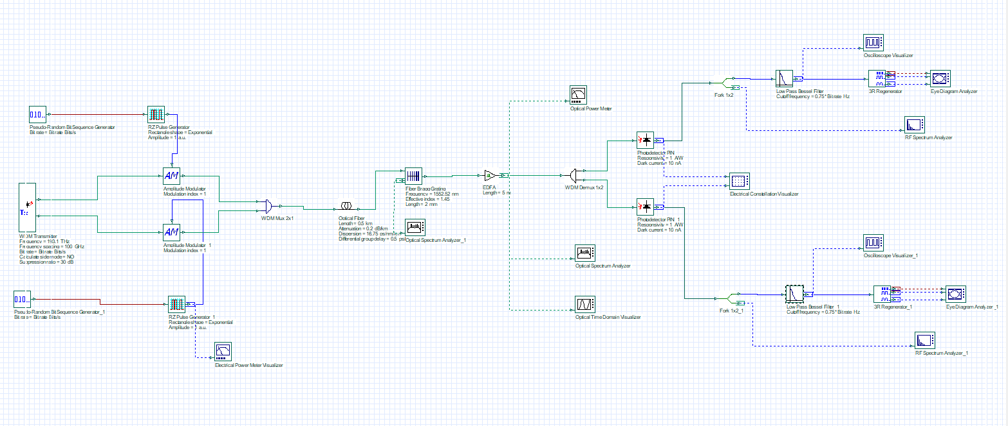
Figure: (a) Amplitude-Modulator-based-RoF-link

Slide 7
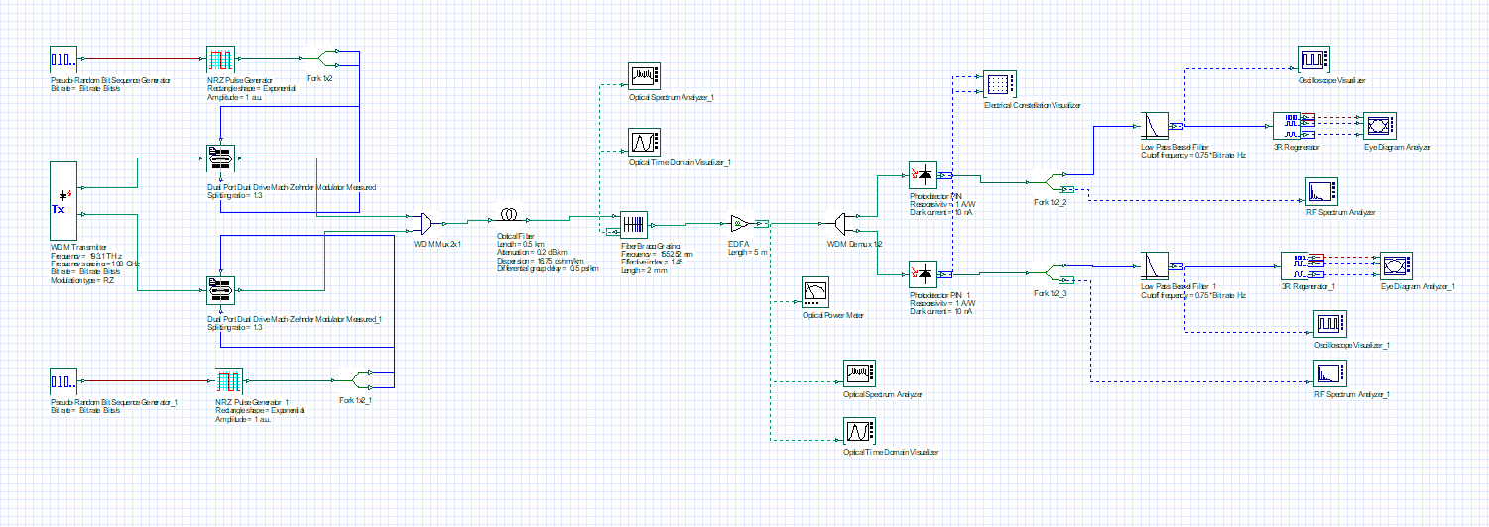
Figure: (b) Dual-Drive-MZM-based-RoF-link

Slide 8
Literature Review
1
MIMO and Radio-over-Fiber Systems
2
Optical Modulators for Millimeter-Wave Signal Generation
3
Challenges in MIMO-Based RoF Systems
Multiple-Input Multiple-Output (MIMO) systems have revolutionized wireless communication by significantly enhancing spectral efficiency, data rates, and network reliability.
Optical modulators are indispensable components of RoF systems, converting electrical signals into optical signals to facilitate the transmission of mm-wave signals over optical fibers.
Despite their numerous advantages, MIMO-RoF systems face several technical challenges: Optical Power Loss, Signal Distortion, and Scalability.

Slide 9
System Design
Model 1: Amplitude Modulator-Based MIMO-RoF System
Model 2: Dual-Drive Mach-Zehnder Modulator (DD-MZM) Based MIMO-RoF System
This model demonstrates a MIMO-RoF system employing Amplitude Modulators (AM) to generate and transmit millimeter-wave signals.
This model uses DD-MZMs for enhanced performance in generating and transmitting millimeter-wave signals.
Transmitter Side
Transmitter Side
Fiber Link
Fiber Link
Receiver Side
Receiver Side

Slide 10
Results & Discussion
S/No.
Devices (Model Number)
Parameter
Values
1
NRZ & RZ Pulse Generator
Rectangle Shape
Exponential
Amplitude
1 a.u.
2
Amplitude Modulator
Modulation Index
1
3
Dual Port Dual Drive Mach Zehnder Modulator (MZM)
Splitting Ratio
1.3
4
Optical Fiber
Length
5m
5
Optical Fiber
Attenuation
0.2dB/km
Dispersion
16.75 ps/nm/km
Differential Group Delay
0.5 ps/km
6
Fiber Bragg Grating
Length
2mm
Effective index
1.45
Frequency
1552.52nm
7
Photodetector PIN
Responsivity
1A/W
Dark Current
10nA
8
Low pass Bessel Filter
Cutoff Frequency
0.75\*Bit Rate Hz

Slide 11
Result representation

Slide 12
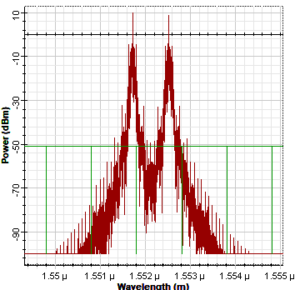
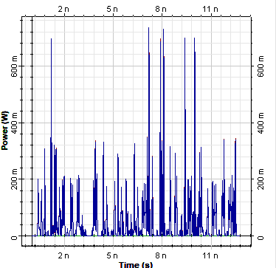

Results
FIGURE 1. Optical Power Spectrum of RoF link using AM: (a) frequency domain; (b) time domain & (c) Power Meter

Slide 13
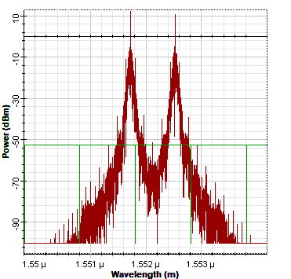
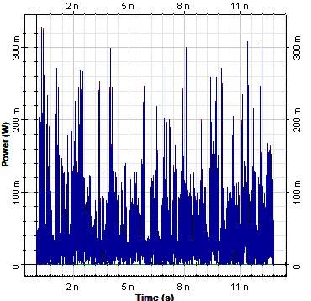
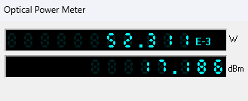
Results
FIGURE 2. Optical Power Spectrum of RoF link using Dual drive MZM: (a) frequency domain; and (b) time domain

Slide 14
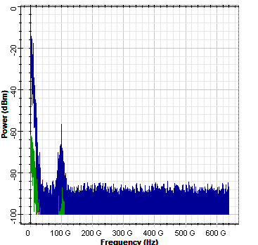
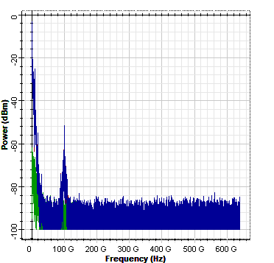
Results
FIGURE 3. (a) RF Power Spectrum of AM-based design (b) RF Power Spectrum of Dual drive MZM-based design

Slide 15
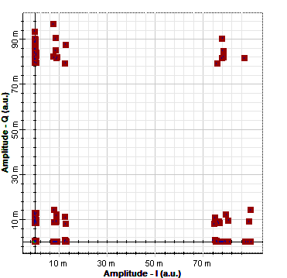
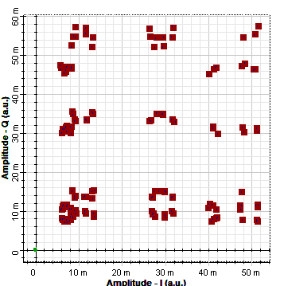
Results
FIGURE 5. Constellation Visualizer output: (a) RoF link with AM; and (b) RoF link with DD-MZM

Slide 16
Methodology
System Design:
Developed two MIMO-RoF models using OPTISYSTEM software: a) Amplitude Modulator (AM)-based. b) Dual-Drive Mach-Zehnder Modulator (DD-MZM)-based.
Key components include pseudo-random bit sequence generators, modulators, WDM MUX/DEMUX, optical fibers, and photodetectors.
Simulation:
Conducted simulations to analyze optical and RF spectra, signal integrity, and modulation performance.
Evaluated systems on Q-factor, Bit Error Rate (BER), and spectral efficiency.

Slide 17
3.Comparison:
Assessed AM and DD-MZM-based systems for sideband suppression, power efficiency, and signal distortion.
4.Results:
Demonstrated feasibility for high-frequency mm-wave generation in 5G networks and beyond.

Slide 18
Conclusion
This study presents a comprehensive modelling of a 2×2 MIMO-based Radio-over-Fiber (RoF) system for millimeter-wave generation, utilizing two distinct optical modulators.
Dual-Drive Mach-Zehnder Modulator (DD-MZM) efficiently generates high-frequency signals with multiple power peaks, achieving frequencies up to 60 GHz.
The Amplitude Modulator (AM)-based RoF link achieves a Q-factor of 4 to 6,with so much noise and Bit Error Rate (BER) over a 0.5 km optical fiber.
This work highlights the potential of tailored MIMO-based RoF systems in addressing the growing demands for high-frequency, high-capacity, and low-latency communication networks.

Slide 19
Thank
You

